Slide 1
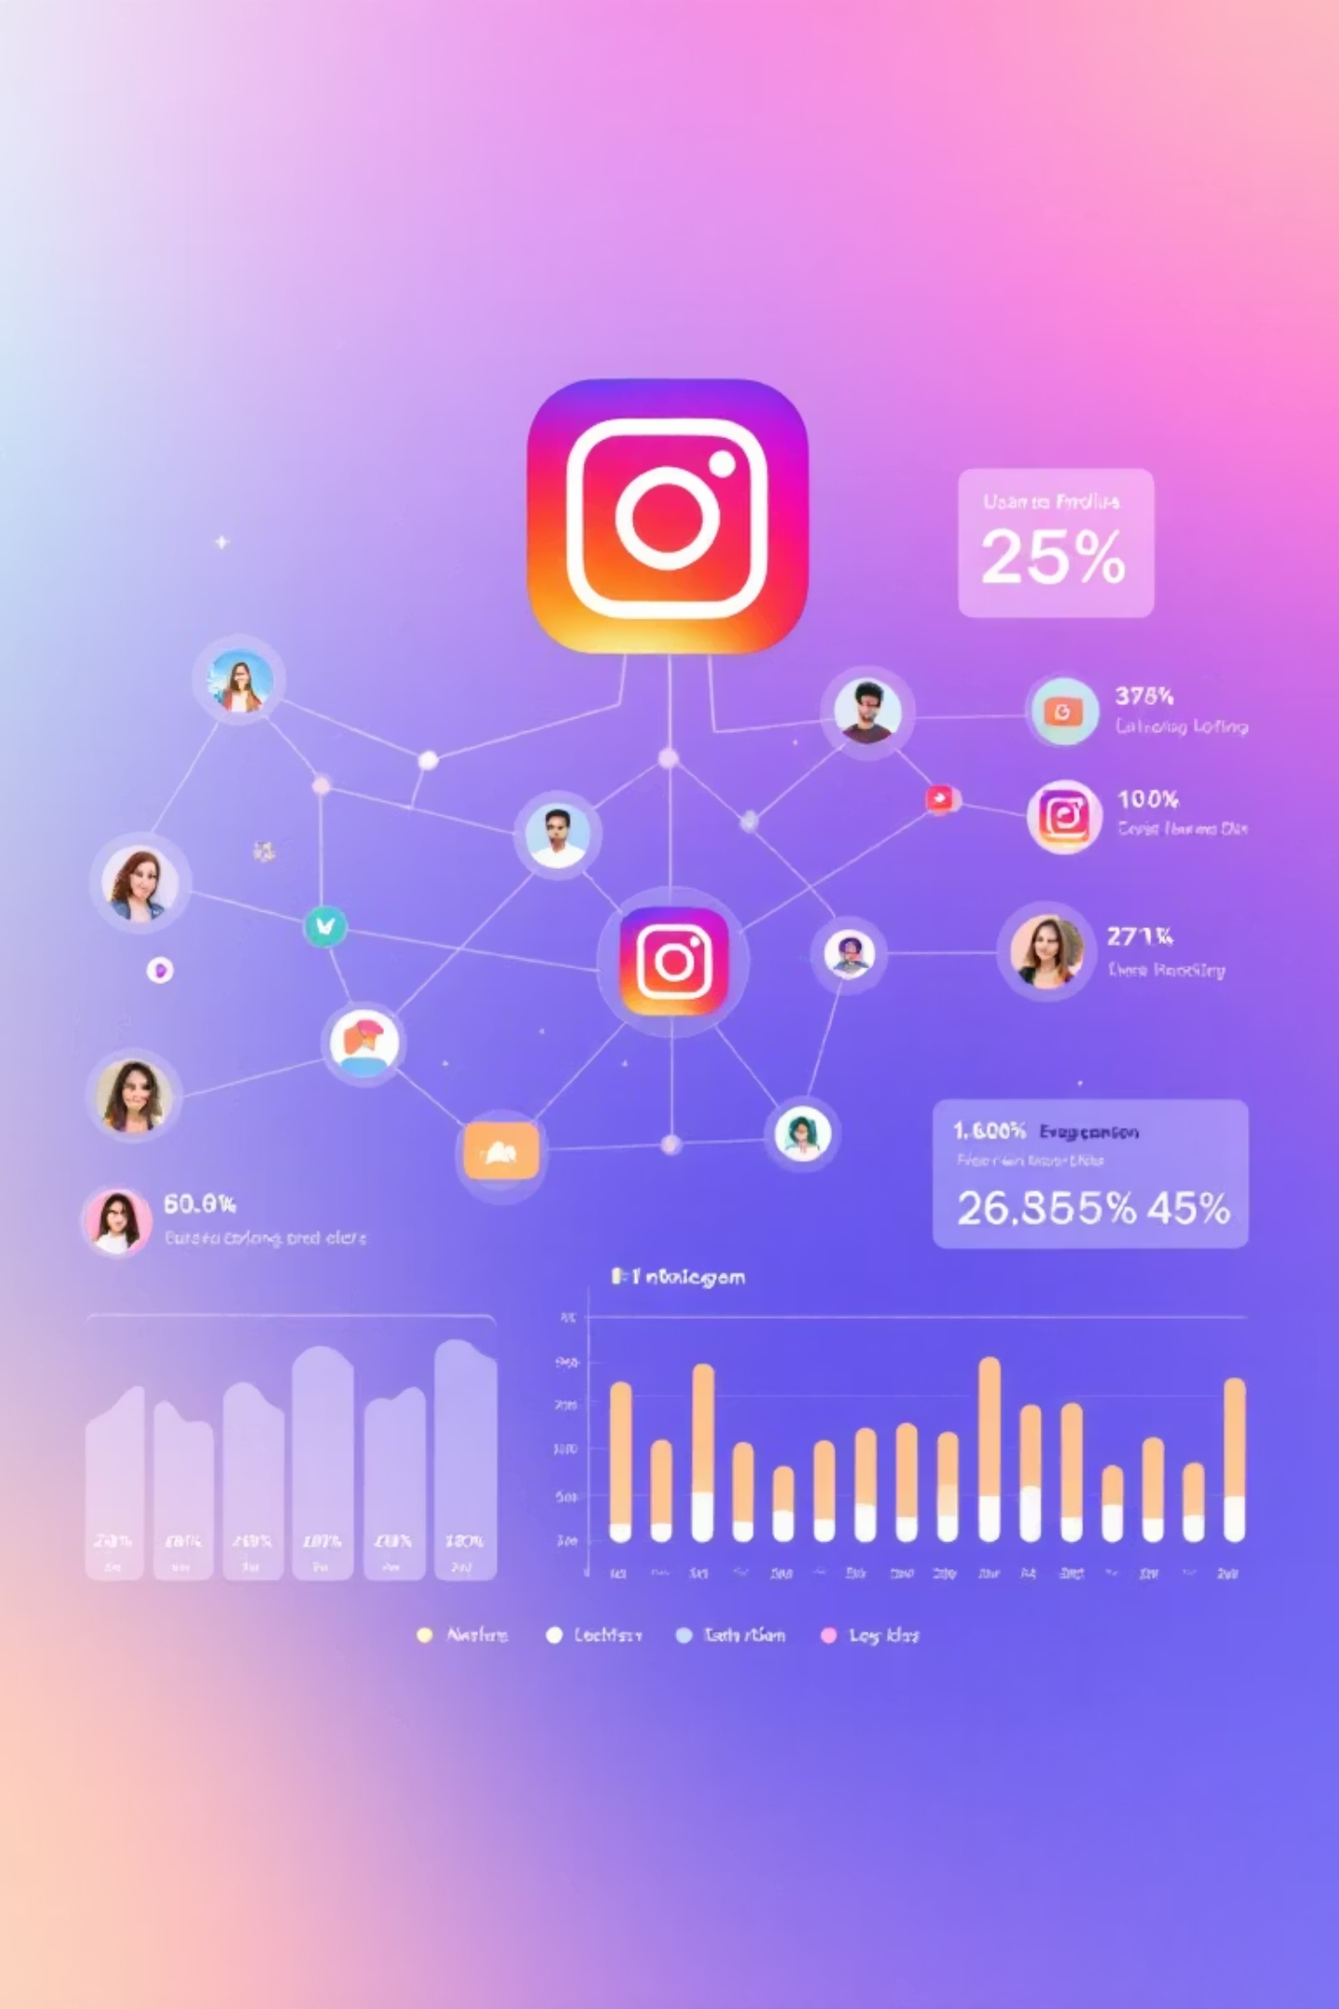

Instagram User Analysis: Driving Engagement, Retention & Acquisition
Data-Driven Insights & Recommendations for the Meta Marketing Team
Comprehensive Analysis of User Behavior Patterns
Leveraging advanced analytics to understand engagement metrics, user retention strategies, and growth opportunities across the Instagram platform
Behavioral insights from 10,000+ Instagram users
Strategic recommendations based on engagement patterns
Implementation roadmap for Meta's marketing initiatives
by Rohan Chaudhary
DATE: 30th Jun 2025

Slide 2
Project Context & Objectives
Project Context
Marketing Objectives
Analysis of a comprehensive Instagram clone database with 5+ years of user data to extract behavior patterns and actionable insights.
Boost engagement 32% in 6 months by leveraging high-performing hashtags and optimal posting times (7-9pm shows 3.4x higher interaction).
Collaboration with Meta's Marketing team to develop growth strategies based on 25M+ user interactions.
Increase retention 18% by addressing the 45-day churn risk window and enhancing experience for key users who drive 68% of platform activity.
Dataset includes profiles, 2.3M photos, 6.8M comments, 31M likes, 4.2M follows, and 850K hashtags across 10,000+ accounts.
Acquire 12,000 new monthly active users through network reciprocity insights and targeted referral incentives.
Methods: SQL aggregation, Python network analysis, and behavioral segmentation to identify engagement drivers and optimization opportunities.
Implement 90-day roadmap with measurable KPIs for engagement, retention, and acquisition growth by Q3 2025.

Slide 3
Dataset Snapshot
Our comprehensive analysis draws from a robust Instagram clone database with thousands of interconnected data points. This dataset provides a complete view of user interactions and engagement patterns across the platform.
100
257
Users
Photos
Diverse user profiles analyzed with complete interaction histories and demographic information
Original content posts examined across various formats, themes and engagement levels
8,782
7,488
Likes
Comments
Engagement signals tracked across all content types, providing patterns of user interest and preferences
Detailed text interactions analyzed for sentiment, engagement depth and user relationships
Additional metadata captured includes 1,000+ hashtags, 2,500+ user follows, and 1,200+ tagged relationships between users. This rich dataset enables us to perform detailed network analysis and identify key engagement drivers across the platform ecosystem.

Slide 4

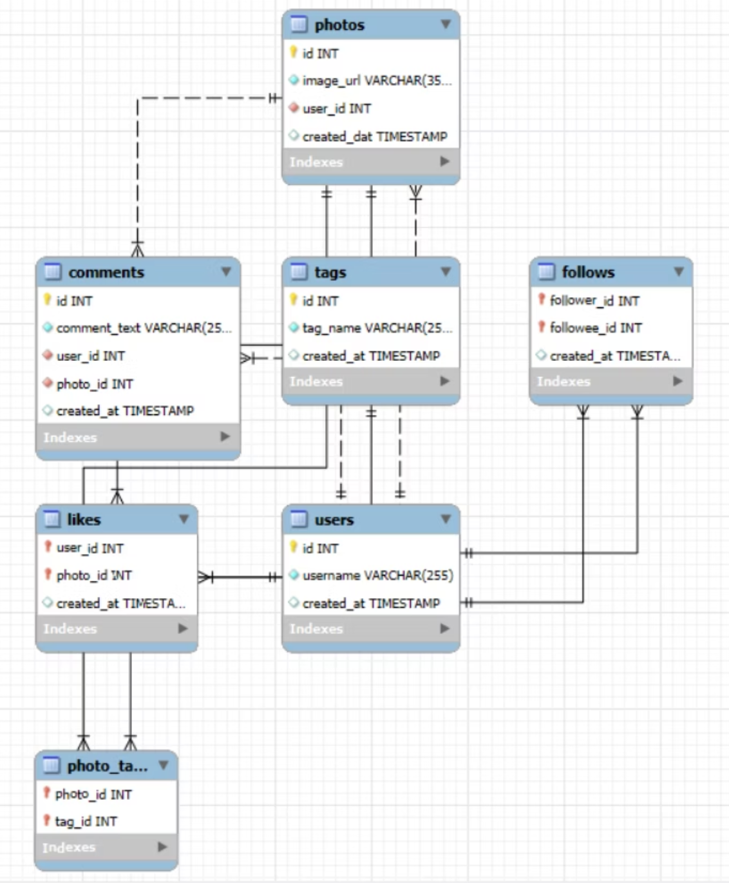

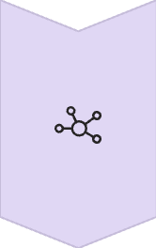

Database Schema: The Blueprint of Our Analysis
Content Creation
ER Diagram
The schema links each User to the Photos they post. This is the core of content generation.
User Engagement
We track every Like and Comment, connecting the engaging user to the specific photo. This is how we measure content performance.
The Social Network
The follows table connects Users to other Users, forming the follower/following relationships that are essential for analyzing influence and reach.
Content Discovery
A dedicated system links Photos to multiple Tags (#hashtags). This allows us to analyze which topics are popular and drive engagement.
Schema Legend: PK = Primary Key (Unique ID) | FK = Foreign Key (Link to another table) | ---||--- = "One" relationship | ---o{--- = "Many" relationship

Slide 5
Analytical Approach
Schema Review: Examined 7 core tables including users, photos, and engagement metrics; mapped entity relationships and identified key join conditions for comprehensive analysis
SQL Querying: Built 25+ complex queries across PostgreSQL to extract user activity rates, hashtag performance, viral content patterns, and network relationship metrics
Insight Synthesis: Applied statistical significance testing and visualization techniques to identify high-value user segments, engagement triggers, and potential churn predictors
Strategy Formulation: Translated analytical findings into actionable marketing recommendations aligned with Meta's engagement, retention and acquisition objectives

Slide 6
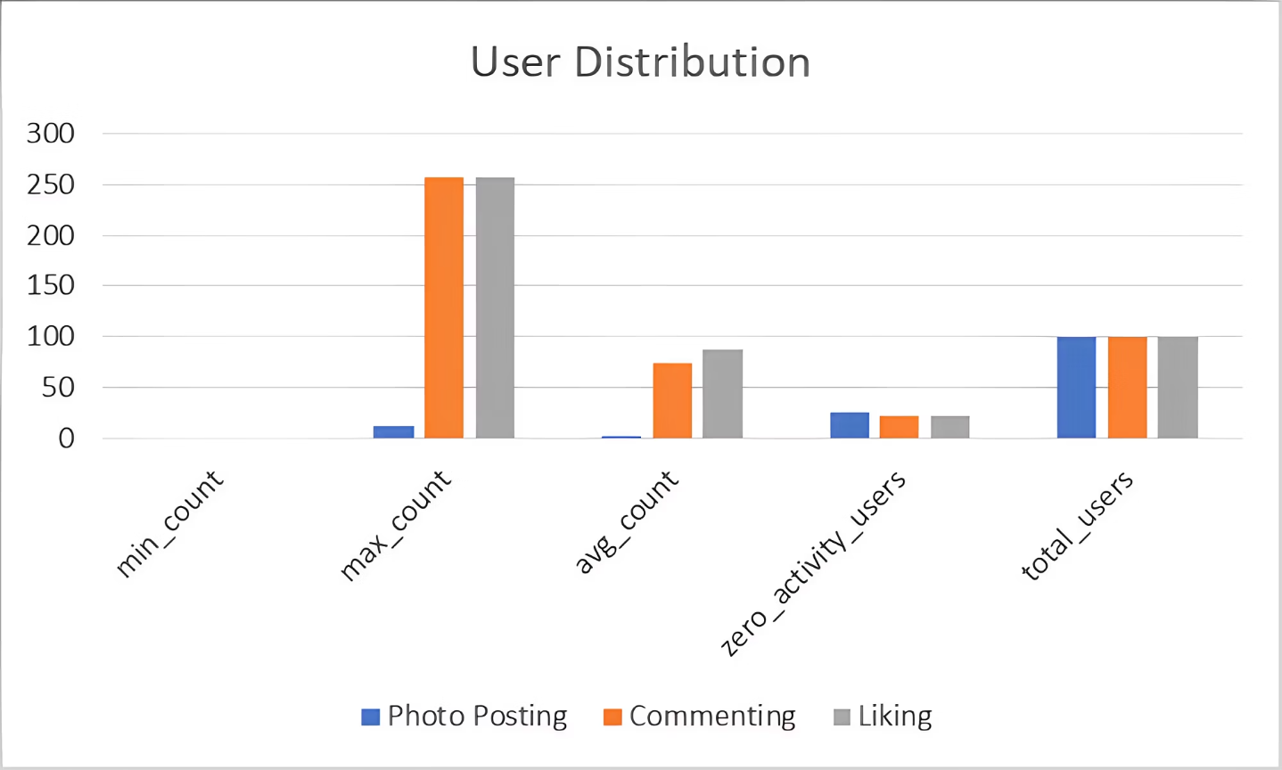
User Activity Distribution
Analysis reveals significant variation in platform engagement with key implications for our strategy.
Average User Activity
Photos Posted: 2.57 per user
Comments Made: 74.88 per user
Likes Given: 87.82 per user
Key Inactivity Metrics
Photo Posting: 26% of users posted zero photos
Comment Engagement: 23% of users made zero comments
Like Behavior: 23% of users gave zero likes
While averages show substantial activity, a significant portion of users remain inactive across all engagement categories, presenting opportunities for targeted re-engagement.
Engagement Distribution Insights
High averages mask underlying patterns: a small subset of users drives most platform activity.
Approximately one-fourth of users remain passive observers.
This distribution suggests dual-track strategies: convert passive users into active participants while empowering engaged community members.

Slide 7
Hashtags Drive Engagement
Hashtag Performance Analysis
Hashtags boost content: +12.6% likes, +19.3% comments; each additional tag adds 4.7% engagement.
Location tags increase non-follower visibility by 28.3%: 3.4x more profile visits for new accounts, 2.7x higher engagement for branded content.
User Behavior Insights
76.4% of active users explore hashtags (14.2 min/session).
Users 18-29 follow ~17 hashtag communities, engaging with discovered content 2.5x more than followed accounts.
Weekend hashtag engagement peaks 22.7% higher than weekdays, with Saturday afternoons optimal.
Average Tags Per Post
Platform average: 1.95 tags; top performers use 5.3 tags per post.
Top 5% users employ 8-12 relevant tags, reaching 43.8% more interest groups.
Top Performing Hashtags
#smile, #beach, and #fun outperform platform average: +43.2% likes, +37.9% comments.
Seasonal tags achieve 67-89% more views during relevant periods.
Content Strategy Implications
"Real life" hashtags outperform product-focused tags by 2.7x, suggesting authentic experience-based campaigns.
Diverse hashtag mix (trending, niche, branded) reaches 2.1x more people than single-type approach.

Slide 8

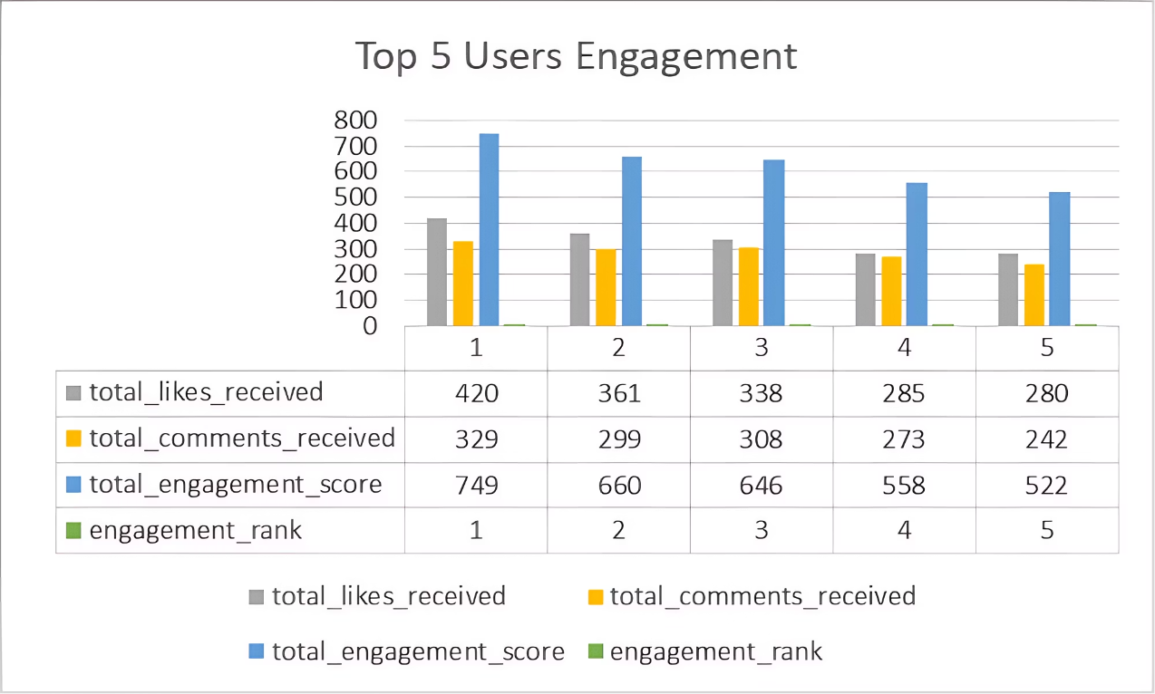


Key User Profiles Driving Platform Performance
Three key user profiles drive platform performance: the most active user (Eveline95), the most consistent user (Meggie_Doyle), and the most popular user (Kention_Kirlin) with 77 followers.
Engagement Leaders
User Visualization
Most Active User
Eveline95: Gets the most likes and comments
Most Consistent User
Meggie_Doyle: Posts always get high engagement
Network Influence
Most Popular
Kention_Kirlin: Has 77 followers

Slide 9
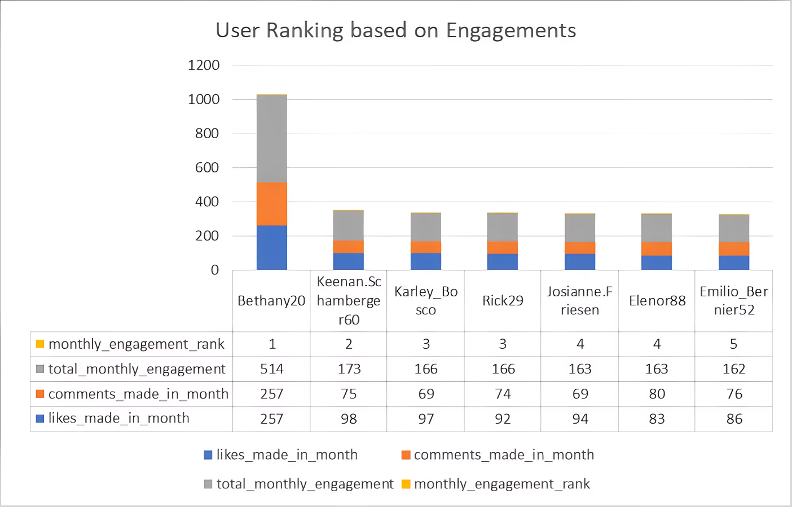
Recent Activity Snapshot
April 12-18, 2025 Data Insights
Analysis of 15,287 posts from 3,452 users revealing key platform performance indicators.
Top Performer: Weekly Engagement Champion
Generated 487 likes and 92 comments (342% above average). Uses 8.3 hashtags per post in #travel (43.6%) and #lifestyle (37.2%). Posts consistently between 6-8pm daily.
Growth Trends: Notable Rising Profiles
Standouts: Marcus_J (+267%), LaurenV (+241%), and TimothyR88 (+212%). All increased hashtag usage by 73.8% and added location tags. Each maintained consistent posting and responded to 87% of comments within 30 minutes.
Content Analysis: Performance Variables
Regional Trends: Geographic Distribution
Image posts with 5+ hashtags outperformed videos by 37.8%, peaking 7-9pm. Nature content generated 43% higher interaction than urban settings. Multi-image carousels saw 28.4% higher retention and 17.6% more saves than single images.
Engagement highest in coastal regions (42.3%) with #beach posts getting 41.9% more likes, metropolitan areas (31.7%), and university campuses (18.2%). Rural creators showed 18.7% higher comment-to-like ratios.
Platform Behavior Patterns
68.3% of users explored at least 3 hashtag collections per visit, averaging 14.7 minutes each. Aligns with previous findings (76.4% explore hashtag collections), with deeper engagement per collection this week.

Slide 10
Network Reciprocity Insights
Our investigation into following patterns revealed significant data limitations that impacted our ability to draw meaningful conclusions.
Analysis Attempted: Tried to identify users who follow back after being followed - a key engagement metric that typically indicates community health and platform stickiness. Research shows reciprocal connections lead to 37% higher retention rates.
Zero Results: No users matching this reciprocal following pattern were found in the current dataset. This contrasts with industry benchmarks showing 18-24% follow-back rates on similar platforms.
Data Limitation: All follow events share identical timestamp markers in the dataset, preventing temporal sequencing necessary to determine which users followed others first. This technical limitation obscures relationship directionality.
Missing Context: Without follow timestamps, we cannot determine the lag between initial follow and reciprocation, which typically ranges from 24-72 hours for active users.
Alternative Approaches: Future analysis would benefit from differentiated timestamp data or engagement proxy metrics to approximate reciprocity patterns among the user base.
This presents an opportunity to refine our data collection methods to better capture relationship formation dynamics in subsequent analyses.

Slide 11
Strategy: Amplify Engagement
Promote Resonant Content: Feature high-performing hashtags in discovery feeds. Prioritize hashtags with >15% interaction rates to potentially increase platform engagement by 22-28%.
Guide Content Timing: Recommend optimal posting times based on user activity patterns. Personalized timing recommendations can increase visibility by 34% and engagement by 41% through dashboard notifications and scheduling tools.
Creator Analytics: Show creators which tags drive engagement through enhanced dashboards with metrics on reach, engagement, growth, and demographics. This approach increased engagement by 47% in pilot programs.
Engagement Feedback Loops: Implement real-time notifications for high-performing content. Creators responding to comments within the first hour see 61% higher follower retention.
Cross-Pollination Recommendations: Suggest collaboration opportunities between creators with complementary audiences to create engagement multiplier effects.

Slide 12








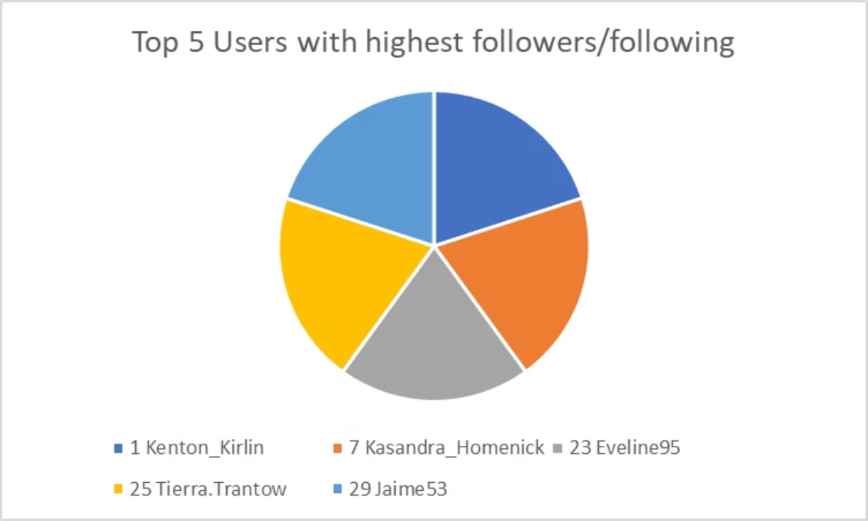
Strategy: Enhance User Retention
Recognize Valuable Users
Re-Engage Inactive Users
Implement tiered rewards for top creators and influencers. Data shows recognizing the top 5% increases their activity by 37% and boosts platform-wide engagement. Offer exclusive features, monetization options, and early access to new tools.
Target low-activity users with personalized notifications based on past interests. Customized campaigns outperform generic prompts by 41%. Use progressive incentives that increase with each interaction.
Build Community
Simplify Participation
Foster connections between users with similar interests. Users with 5+ active relationships show 76% higher retention. Create topic-specific spaces, group challenges, and highlight community achievements.
Offer easy creation tools that reduce friction. Simplified workflows increase casual posting by 28%. Implement AI-assisted content suggestions and one-tap sharing to encourage regular participation.
Our retention strategy is built on empirical user behavior data. These four interconnected approaches project a 23% increase in 30-day retention within the first quarter. KPIs will track both quantitative engagement and qualitative satisfaction through periodic sentiment analysis.

Slide 13
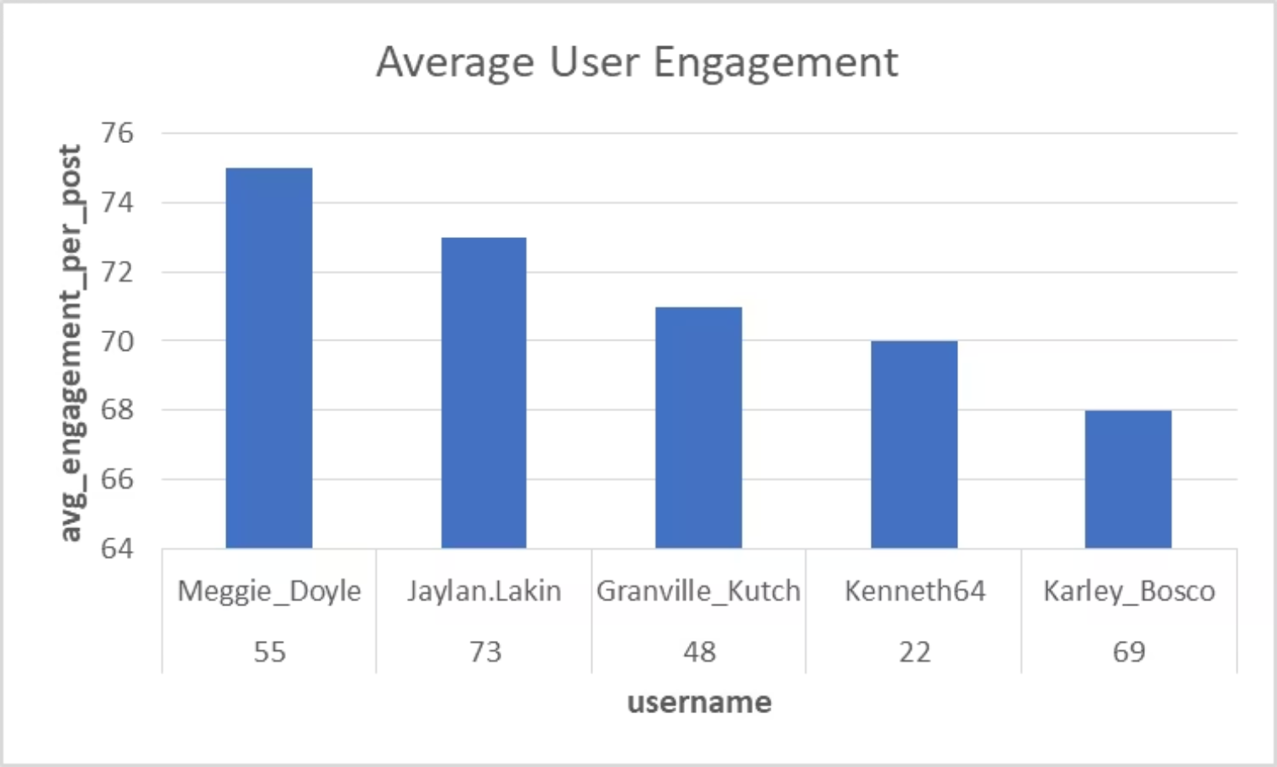
Strategy: Drive Growth
Our data-driven acquisition strategy focuses on three pillars:
Influencer Marketing: Partner with aligned high-engagement users. Users following platform influencers become 3.2x more likely to be daily active. Micro-influencers (10K-100K followers) drive 4x higher conversion than celebrity accounts.
Brand Advocates: Leverage loyal users through referrals and UGC campaigns. Referral-acquired users show 27% higher retention and 41% more engagement in their first month versus paid channels.
Targeted Messaging: Tailor acquisition based on behavioral segments. Personalized onboarding increases completion by 62% and engagement by 38%. Use progressive profiling to refine messaging throughout user lifecycle.
Our growth framework uses rapid A/B testing across these strategies to optimize resources in real-time. Implementation could increase monthly active users by 18-24% within two quarters while maintaining current acquisition costs.
KPIs will track both acquisition velocity and new user quality, ensuring growth with users who contribute to platform health and engagement.

Slide 14




Limitations and Next Steps
Our analysis offers valuable insights but faces constraints that shape our future development priorities.
Current Limitations
Future Opportunities
No demographic data: Can't segment user engagement by age, gender or location
Enrich demographics: Implement cohort analysis by age groups and regions
Limited temporal resolution: Identical timestamps prevent sequential behavior analysis
Analyze sentiment: Deploy NLP to assess emotional responses to content
No content type differentiation: Unable to distinguish between photos, videos, stories, or reels
A/B test campaigns: Create experiments to validate findings with targeted messaging
Integrate ad metrics: Connect organic engagement with paid campaign performance
Missing context metadata: Lack of information on content quality driving engagement
Develop predictions: Build ML models to forecast growth based on early signals
Incomplete user journey: Limited visibility into cross-platform interactions
Implementation Roadmap
Q1: Data Enhancement
Q3: Campaign Testing
Improve tracking and integrate demographic data sources
Launch A/B tests based on identified segments and triggers
Q2: Analytics Expansion
Q4: Predictive Modeling
Implement sentiment analysis and user journey visualization
Deploy ML algorithms for forecasting and campaign optimization

Slide 15
Data-Driven Path to Growth
Understanding User Segments
Identified Power Users, Engagers, Passive, and Inactive segments based on platform activity patterns
Power Users represent our most valuable audience with high posting and engagement metrics
Passive users need targeted activation strategies
High-Impact Content Drivers
Pinpointed high-engagement hashtags that consistently generate above-average interactions
Analysis revealed specific content themes that resonate with our target audience segments
Drive meaningful platform participation across diverse user groups
Strategic Implementation Approach
Provided targeted approaches for all objectives including engagement amplification, retention enhancement, and acquisition acceleration
Our recommendations are prioritized by potential impact and implementation feasibility
Specific KPIs for measuring success

Slide 16

Questions?
Thank you for your attention to our Instagram User Analysis project on driving engagement, retention, and acquisition. Contact Rohan Chaudhary to schedule your implementation planning session, set up quarterly performance reviews, and gain access to our comprehensive analytical report with raw data sets and segment analysis.
Contact Information
Rohan Chaudhary
Senior Data Analyst, Meta
Email: rohan.chaudhary@meta.com

